Slide 1

{Dev}School DevOps Edition 2023
Andrada Raducanu, Delia Bizu, Liviu Varia
February 2023

Slide 2

Agenda
Who are we?
Who are you?
The program
The calendar
Welcome word

Slide 3

Who are we?
{Dev}School DevOps Edition Core team

Slide 4
Andrada Raducanu

Slide 5




Delia Bizu

Slide 6
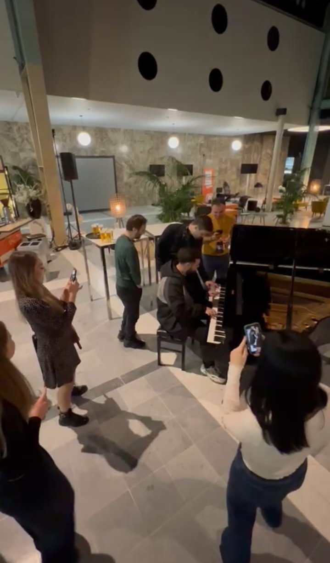
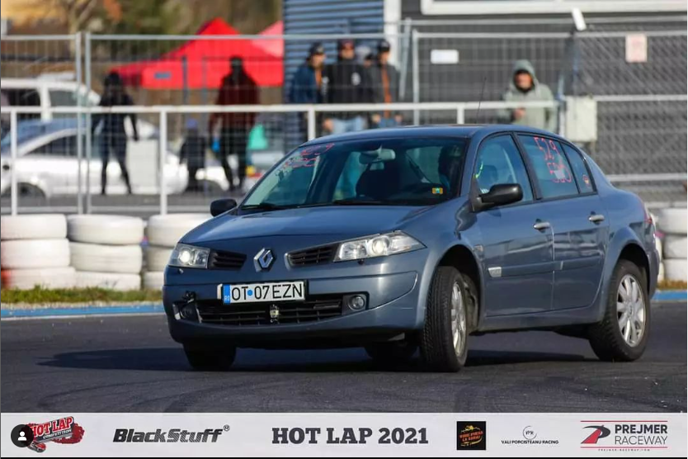
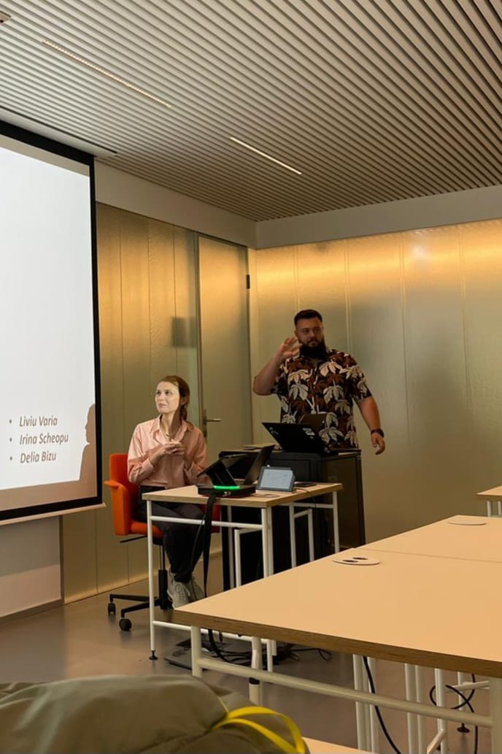
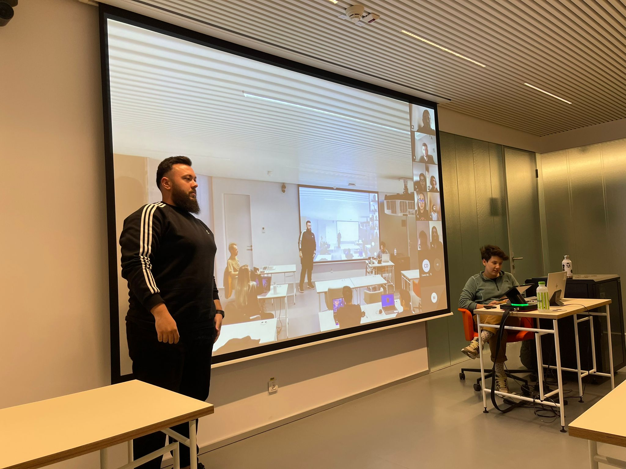
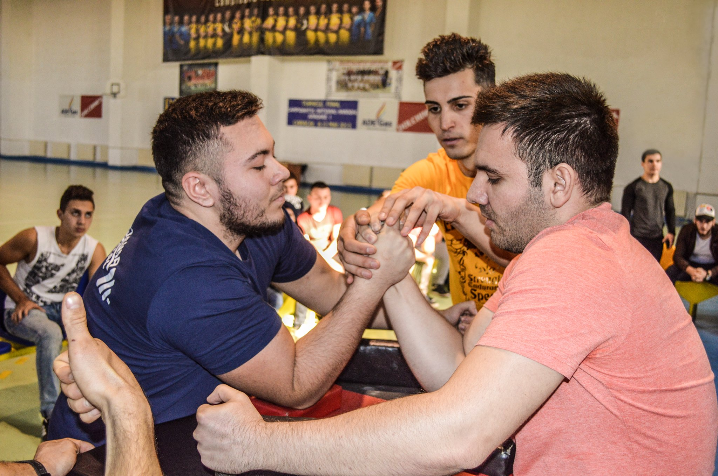
Liviu Varia

Slide 7
Who are you?
Hobbies, passions, interests

Slide 8
Welcome word
from Maria Gheorghe, IT Lead of Data Management

Slide 9
The program
13 lessons (theoretical and practical, some of them will have homeworks)
lesson 11 reserved for planning the final project
lesson 13 reserved for presenting the final project

Slide 10
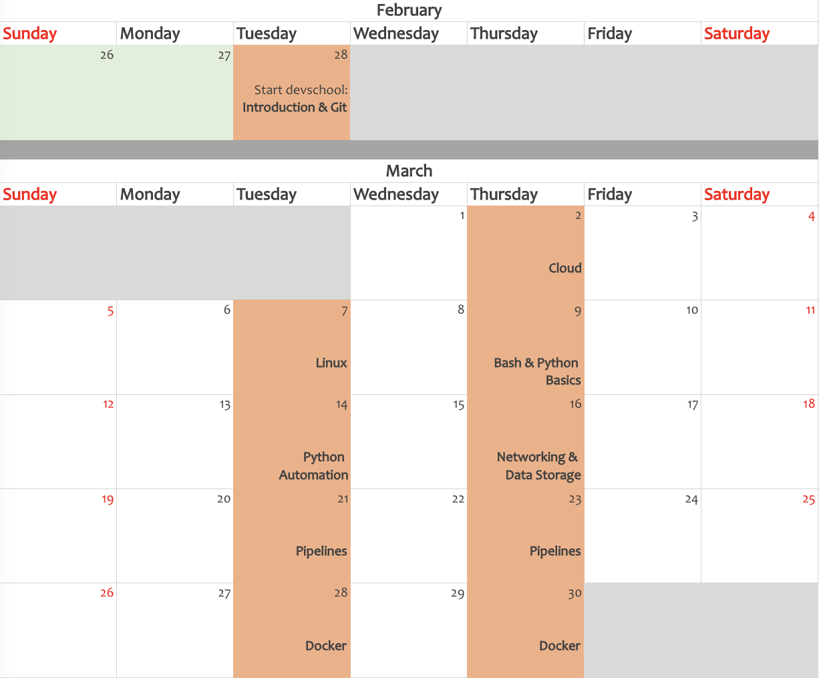
The calendar

Slide 11
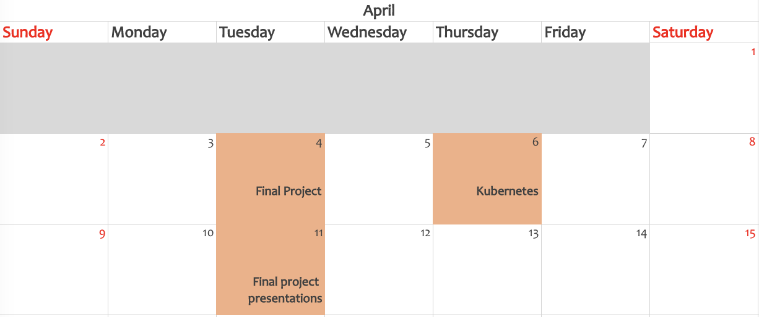
The calendar

Slide 12








Thank you!
ing.com
@ING_News
LinkedIn.com/company/ING
SlideShare.net/ING
Medium.com/ing-blog
ingwb.com
Facebook.com/ING
YouTube.com/ING
Flickr.com/INGGroup

